Slide 1
Portfolio Website
By Emma Cullen

Slide 2
Features
Home
About
Projects
Contact

Slide 3

Design process

Slide 4
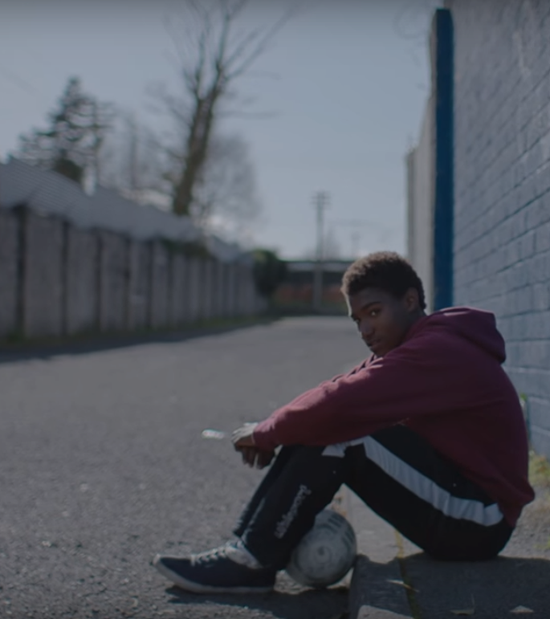
Decisions

Slide 5
Developement
Challenges
Ethical issues
Favourite parts

Slide 6
Challenges

Slide 7
Ethical issues

Slide 8
Favourite parts

Slide 9
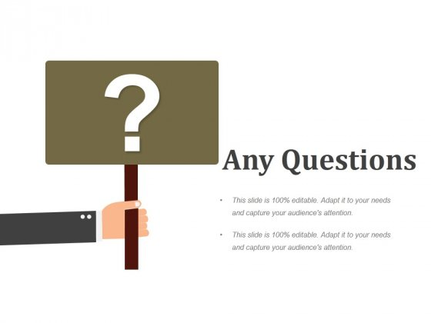
Any questions ?

